Slide 1
A few Topics of International Concern:
Sustainable Development, Circular Economy, Climate Change
Slide Set 4
How did the concern on Environmental Protection take shape ? A chronology
1968 - The term Sustainable Development appears for the first time in a document prepared by International Union for the Conservation of Nature (IUCN) – a global environmental network.
The document was signed by 30 African countries
– pledge for conservation of natural resources
1969 - National Environmental Policy Act (NEPA)- 1969 introduced by the US Govt
1969 - US Environmental Protection Agency established
1972 – UN Conference on Human Environment was held at Stockholm, June 5-16
(June 5 is observed as the World Env day in memory of UNCHU)
Milestone event in the history of environmental protection
World leaders from 115 countries joined
Major issues deliberated upon: Biodiversity, Eco-system integrity, Human health, Limited natural resources, Need for environmental policy at national level in every country
Establishing Regulatory Bodies in each country; Water Act (1974) comes in force in India and CPCB and State Boards established
United Nations Environment Program (UNEP) established
‘Sustainable Development’ as such was not articulated, but it paved the way for future actions
A few things of this set of slides might have been touched upon before.

Slide 2
1979 – IUCN published a report called World Conservation Strategy (WCS) – Living Resource Conservation for Sustainable Development.
The report was commissioned by UNEP
The Report Says:
Sustainable Development should take into account the social, ecological and environmental factors
Repeal the old idea of incompatibility of development and conservation
Poverty Ecological degradation More poverty ,
the chain is to be broken by economic and social development
The report contained background material for the next bigger endeavor of the UN

Slide 3
The Brundtland Commission
Appointed by the UN General Assembly
Chairman; Cro Harlem Brundtland, Prime Minister of Norway
Task: The formulate long tern environmental strategies for achievement of sustainable development
First meeting of the Commission – October 1984
The Commission visited many parts of the world and held widespread interaction and consultation
Submitted Report - Our Common Future – published in December 1987 generating lots of enthusiasm
Came up with the oft-quoted definition of Sustainable Development – that meets the need of the present without compromising the ability of future generations to meet their own needs,
The Commission emphasized that economic development and environmental protection can be made mutually supportive. And the development should be inclusive.

Slide 4
Conclusions of the Commission about the target:
A political system that secures effective citizen participation in decision making
An economic system that is able to generate surpluses and technical knowledge on a self-reliant and sustained basis.
A social system that provides for solutions for the tensions arising from disharmonious development.
A production system that respects the obligation to preserve the ecological base of development.
A technological system that can search continuously for new solutions.
An international system that fosters sustainable patterns of trade and finance, and
A system of administration and governance that is flexible and has the capacity of self-correction.

Slide 5
Poverty and Environment – The Kuznets Curve
The Kuznets Curve The Environmental Kuznets Curve (EKC)

Slide 6
The Rio Summit, 1992
Brundtland Commission Report caused a step jump in environmental concerns and heightened aspirations
UN General Assembly was quick to go for the next step of deliberations
World Conference United Nations Conference on Environment and Development (UNCED) was organized
at Rio de Janeiro in 1992
It was a 12-day long program, 178 nations and 110 Heads of States joined
Formulated the Action Plan Agenda 21 (agenda for the 21st century) guided by Brundtland report
UN Framework Convention on Climate Change (UNFCCC) was agreed upon, that began journey in 1994
Principles 3 and 4 of Agenda 21 are more pressing
Principle 3: The right to development must be fulfilled so as to equitably meet developmental and
economic needs of present and future generations.
Principle 4: In order to achieve sustainable development, environmental protection shall constitute an
integral part of the developmental process and cannot be considered in isolation from it.
Principles 15 and 16 of Agenda 21 suggested the Precautionary Principle and the Polluter Pays Principle as guiding principles of environmental protection.

Slide 7
The Johannesburg Summit, 2002
The Johannesburg Summit was a global meeting to review the progress in implementation of Agenda 21 of UNECED
It renewed the earlier commitment and pledge.
The Johannesburg Declaration urged the developed nations to provide development assistance as agreed upon (0.7% of GNP).
The great role the public sector can play was recognized.
The Summit recognized that it is only through effective democratic and accountable international and multilateral institutions that the goals of sustainable could be fulfilled.
Climate Change - Another big Issue. IPCC already started working.

Slide 8
The United Nations Conference on Sustainable Development,2012 (UNCSD) – Rio + 20
It was held 10 years after Johannesburg and 20 years after the Rio Earth Summit.
The foremost task was to invigorate the efforts of the international community to promote SD
Outcome paper: The Future We Want (Compare: Our Common Future, Brundtland Commission report)
UNCSD endorsed the concept of Green Economy
Green Economy aims at reducing environmental risks and ecological damage in economic activities
The term Green Economy surfaced in the UK in 1989 in a Govt requisitioned report. The role Economics and Economists can play in formulating environmental policy of a country was highlighted in the report
The term revived in 2008 during the last global recession UNEP took the cudgel to popularize it. UNEP also came up with a formal definition – “A Green Economy is one that results in improved human well-being and social equity while significantly reducing environmental risks and ecological scarcities”.
In layman’s words – Green Economy aims at highest efficiency of resource utilization, low carbon footprint, and social inclusiveness. UNEP published Green Economy Report in 2011 that formed the basis of Rio + 20 deliberations.

Slide 9
The Millennium Development Goals (MDG) – 2000-2015 of UNDP
After the Rio meet at 1992, there was no disagreement among the nations that poverty was the most pressing impediment in the way to cleaner environment.
United Nations declared the Millennium Development Goals in September 2000 under United Nations Development Program (UNDP). There were EIGHT GOALS. Time Frame 2000-2015 (15 years)
1. Eradicate extreme poverty and hunger
2. Achieve universal primary education
3. Promote gender equality and empower women
4. Reduce child mortality
5. Improve maternal health
6. Combat HIV/AIDS, malaria and other diseases
7. Ensure environmental sustainability
8. Develop a global partnership for development
UNDP declared great success in achievement of MDG’s, estimated 50% Reduction of number of people living below extreme poverty line
Number of under-nourished people, school dropouts, under-fifty mortality reduced significantly
Quite a few other parameters showed favorable changes.

Slide 10
Sustainable Development Goals (SDG’s)
The program of sustainable Development was chalked out at UNCSD - Rio + 20. The success of MDG’s was a big boost.
A set of seventeen SDG’s were identified; Time Frame 2015-2030.

Slide 11
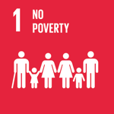
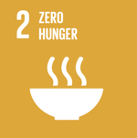



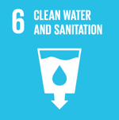
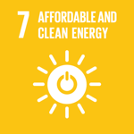
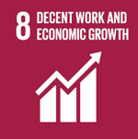

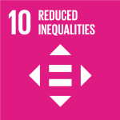
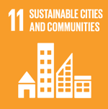
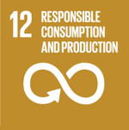
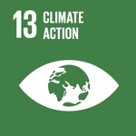
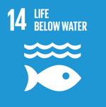
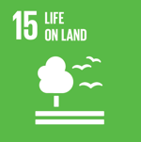

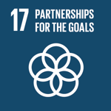

The Seventeen Sustainability Goals of UNDP

Slide 12
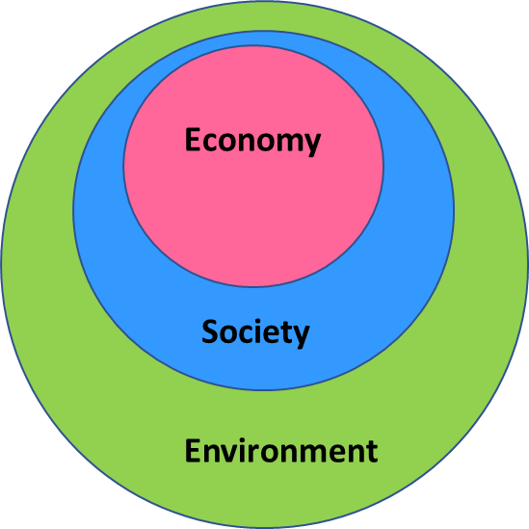
Three Pillars of Sustainability - Economy, Society and Environment
The three pillars or components are often represented by a Nested Diagram or a Venn Diagram
These components or ‘pillars’ are considered for analysis and quantifying sustainability of a process or technology or activity.
The Venn Diagram of three pillar
of Sustainability represented as intersection of three domains
The Nested Diagram of three pillar
Of Sustainability

Slide 13
Conflict between Development and Environmental Protection
The solution is to make any developmental initiative SUSTAINABLE
How to Do it? There should be a multiprong solution
One aspect is conservation of resources, maximize resource utilization, minimize waste generation
Green Economy, Green Technology
Waste Management - The concept of 3R’s - Reduce, Reuse, Recycle
6R’s - Reduce, Reuse, Recycle, Repair, Refurbishing and Remanufacturing.
The Concept of Circular Economy emerged

Slide 14
Waste Management – Green Economy vs Circular Economy
The Green Economy, promoted in Rio+20, is defined, in particular, as “a system of economic activities connected with the production, distribution and consumption of goods and services that results in a better human wellbeing in the long term, to avoid exposing the future generations to significant environmental risks and to the ecologic shortage”. It does not explicitly concern waste management.
The circular economy refers to an economic model whose objective is to produce goods and services in a sustainable way, by limiting the consumption and waste of resources (raw materials, water, energy) as well as the production of waste.
It is breaking with the model of the linear economy, based on a take-makeconsume-throw away pattern, by proposing to transform waste into recycled raw material for product design or other uses.
The circular economy model fits directly into the more general framework of sustainable development. It is part of a global strategy that also uses, among other things, the principles of the green economy, industrial ecology, ecodesign
or the economy of functionality.

Slide 15
Circular Economy (CE)
CE started developing in the 1970s
An alternative economic model, challenging the traditional linear industrial economy.
The linear economy, based on a linear process - high throughput,. Low production costs, relies on the abundant availability of raw materials at relatively low cost.
Resource Extraction
Dispose of at the end of service life
Manufacturing
Consuming
Linear Economy - Take-Make-Consume-Dispose Model; End-of-Pipe solution for Waste Management
CE Model - Low environmental impact by minimising waste and excessive resource use, turns goods at the end of their lifespan into resources for re-use, re-manufacture, re-cycle, waste reduction and other practices. In other words,
CE is restorative by design and intention.

Slide 16
Schools of Thoughts on of Circular Economy
Circular Economy is an economy with closed material loops.
The concept cannot be traced back to a single author, it is the convergence of several schools of thought since 1970’s
The concept evolved from five major schools of thought
Industrial Ecology
waste and by-produced must be valorized
Loss caused by dispersion must be minimized
The economy must be dematerialized
Less dependence on energy from fossil fuels
Cradle-to-Cradle strategy
Articulated first in the book Cradle to Cradle – Remaking the way we make things by W McDonough and
M Braungart (2002)
Eco-Efficient and Ec-Effective Approach
Cyclical Cradle-to-Cradle Metabolism rather than Cradle-to-Grave Approach
The Performance Economy
The Blue Economy - It suggests a cascading flow of materials (like cascading flow of a waterfall)
Biomimicry - Based on the principle that Nature has the best solution for a problem, Natural Processes generate
minimum waste. Recommends following Nature as a Model, nature as a Mentor

Slide 17
The Schools of Thoughts Constituting Circular Economy illustrated

Slide 18
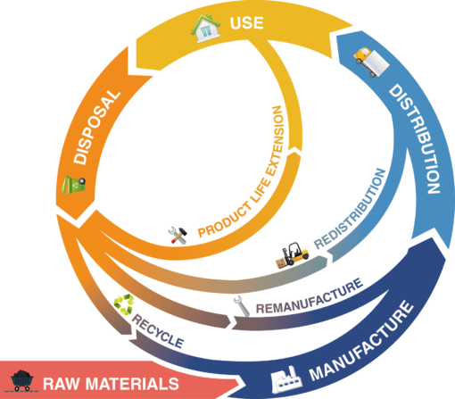

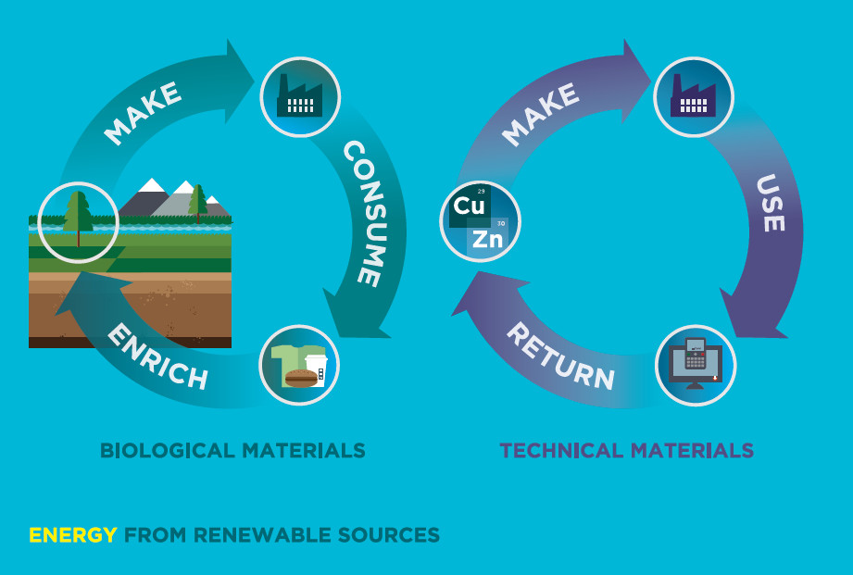
CE aims to minimize – if not eliminate – waste, utilize renewable resources of energy and phase out the harmful substances.

Slide 20
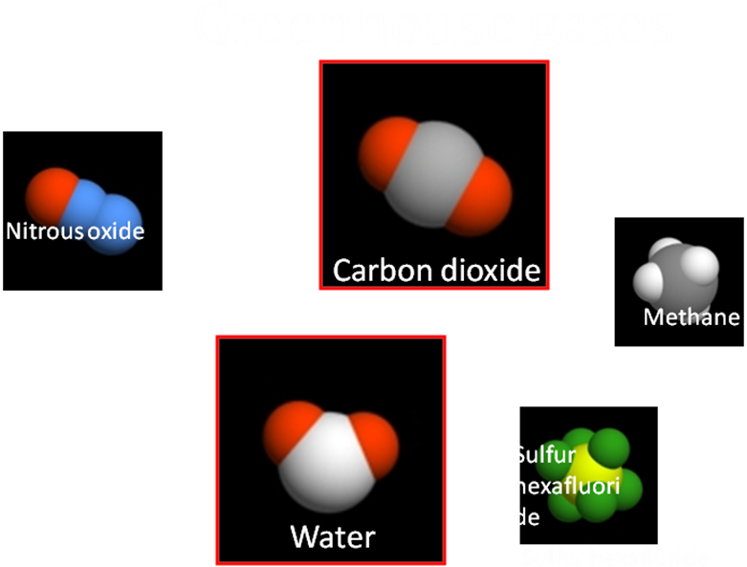
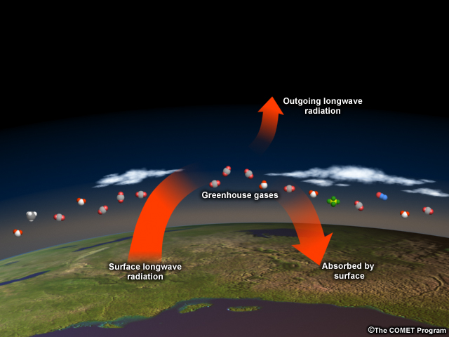
Greenhouse Effect, Global Warming and Climate Change
MONOATOMIC AND DIATOMIC GASES
O₂, Ar, N₂, RADIATE WEAKLY. THESE GASES NEITHER EMIT NOR ABSORB APPRECIABLE AMOUNT OF RADIATION. POLY ATOMIC GASES
H₂O VAPOUR,CO₂,NH₃,SO₂,
N₂O AND HC GASES EMIT
AND ABSORB RADIATION
(IN CERTAIN BAND OF WAVE LENGTHS –IR HEATWAVE).

Slide 21
Increasing concentration of greenhouse gases
Gas | Historic Level | Current Level | Warming potential compared to CO2 | Lifetime in Atmosphere (years)
CO2 | 280 ppmv | 400ppmv | 1 | 5-200
CH4 | 700 ppb | 1720 ppb | 23 | 12
N2O | 275 ppb | 314 ppb | 300 | 114
CFCs | 0 | ppt level | 4000-8000 | 5-100
Perfluoro-methane (PFC) | 40 pt | 80 ppt | 5700 | 50,000
Sulfur Hexafluoride (SF6) | 0.01 ppt | 3 ppt | 22,000 | 3200

Slide 22
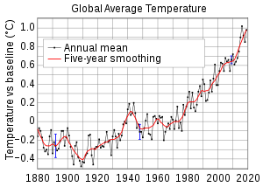
In the next 20 years, temperatures will rise 0.4 °C .
At the end of the 21st century, temperatures will be 1.8–4.0 °C higher than today’s .
Polar areas will have the most intense warming
Sea surface temperatures will rise .
Hurricanes and tropical storms will increase in power and duration .
Source :University of East Anglia’s Climatic Research Unit in the United Kingdom .

Slide 23
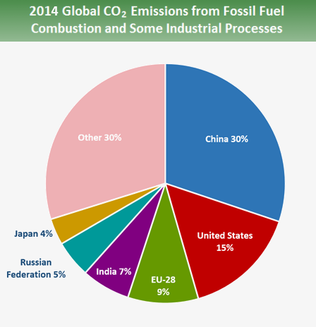
Current total annual; CO2
emission is above 37.15bn tonnes

Slide 24
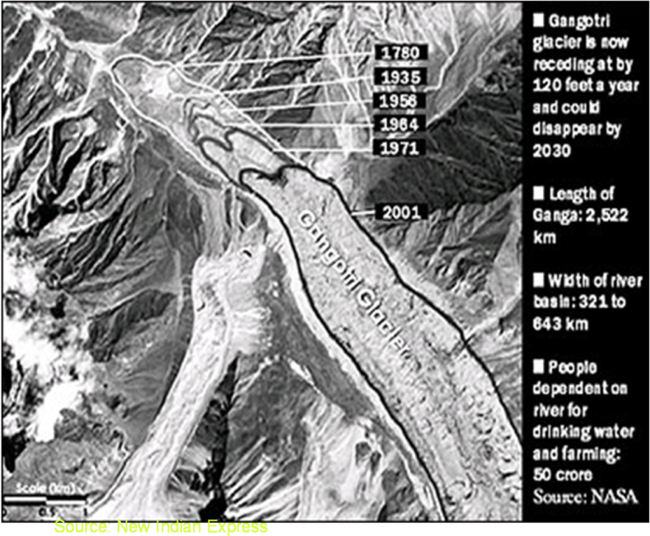
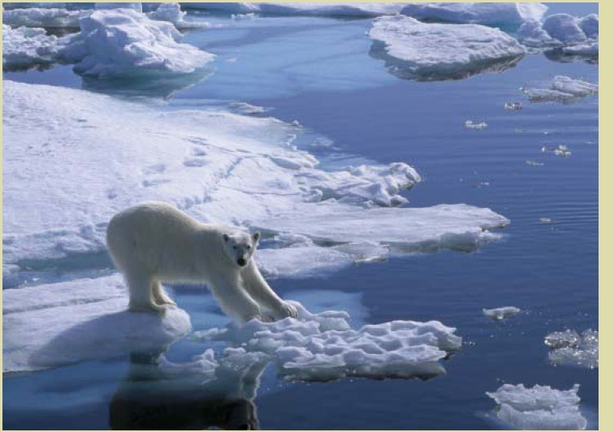
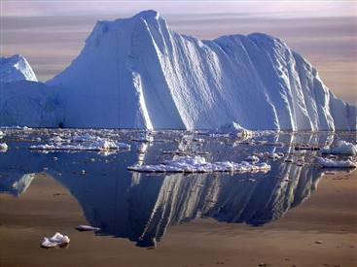
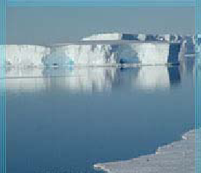
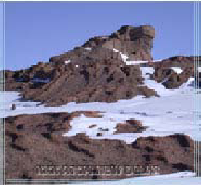
Melting of glaciers , polar ice and ice caps
ARCTIC
Greenland
Antarctic Landscape
Antarctic

Slide 25
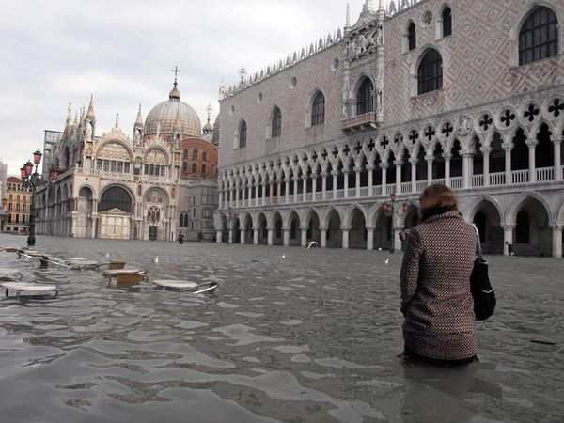
Venice?
No - Downtown Manhattan in 200 years!

Slide 26
International Initiatives on Global Warming and Climate Change
The necessity of critical study of scientific evidences of global warming and climate change was felt strongly starting mid-1980’s.
For this purpose, The Intergovernmental Panel on Climate Change (IPCC) was set up in 1988 by World Meteorological Organization (WMO) and United Nations Environment program (UNEP).
The primary objective was to study the scientific information and evidences of climate change and to prepare comprehensive reviews, reports and recommendations from time to time.
The first IPCC Assessment Report published in 1990 viewed climate change as a potential threat and a big challenge requiring adequate and effective international cooperation.
The international political response to climate change began at the Rio Earth Summit in 1992 and United Nations Framework Convention on Climate Change (UNFCCC) was held first in that Earth Summit in 1992. The objective was to arrive at international treaties on global warming and climate change taking inputs from IPCC.
IPCC prepared the second assessment report in 1995 which was the basis of Kyoto Protocol adopted in Japan in 1997. Decision were taken to reduce CO2 emission including a mandate on developed countries to limit their emission to 1990 level by a given time frame. USA did not sign the Protocol.

Slide 27
International Initiatives on Global Warming and Climate Change
More assessment reports of IPCC followed. The fourth assessment report of 2007 envisaged integration of climate change with sustainable development policies.
IPCC as an organization was awarded Nobel Peace Prize in 2007 when Rajendra Pachauri was its chairman. He was also heading The Energy and Resources Institute (TERI) in New Delhi.
The countries who joined the UNFCCC at Rio in 1992 (and more countries later) meet annually to deliberate on the issues of global warming and climate change under the name Conference of Parties (COP). COP has now 195 countries as members.
COP-21 (21st meeting of the Conference of Parties) held in Paris in December 2015 agreed to take appropriate actions to limit the global temperature rise to well below 2ºC (preferably below 1.5ºC) by the turn of the century.
COP 23 was held at Bonn at Germany during 6-18 November, 2017 and decided upon a number of Sustainable Development Goals besides climate change issues.
COP 24, held in Katowice, Poland in 2018, discussed implementation of various early decisions
COP 25 recently held in Madrid, Spain.

Slide 28
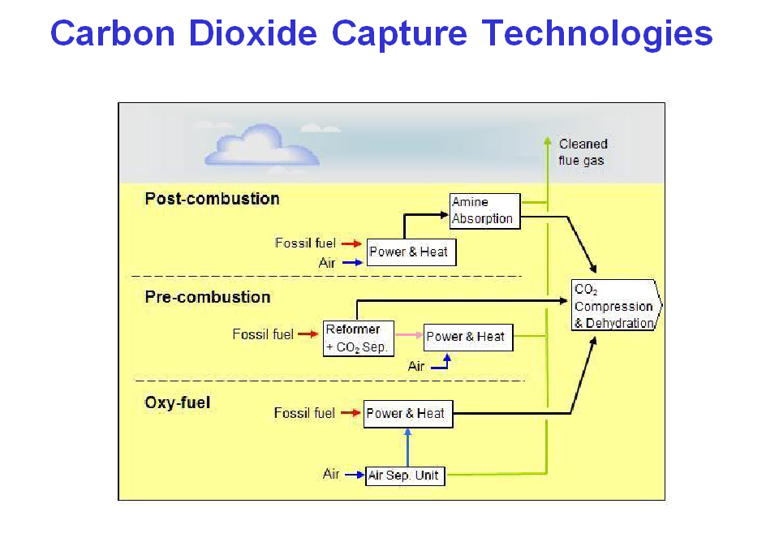
How to mitigate Global Warming?
Reduce emission (1 liter fuel generates about 2.5 kg CO2
Save energy, increase efficiency of energy utilization
Prevent deforestation, enhance afforestation
CO2 Sequestration and Storage

Slide 29
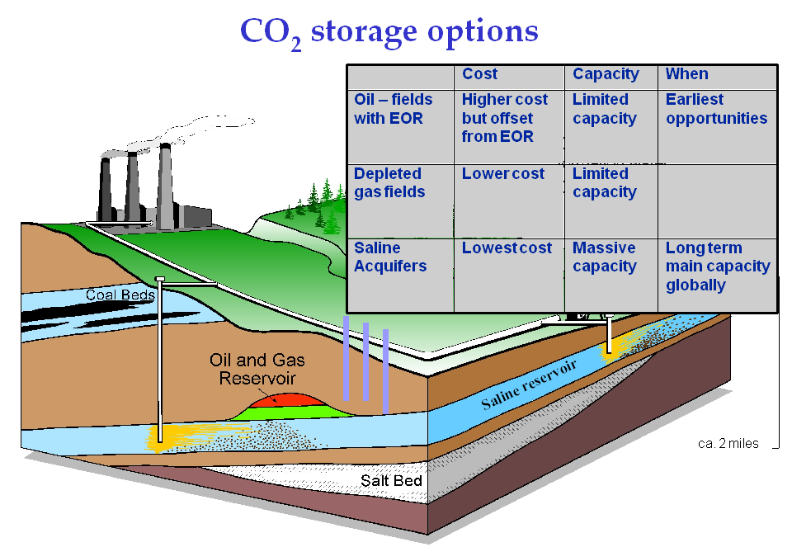
After capture, compress (>70 atmos → liquid) transmit and store (>700m):

Slide 30
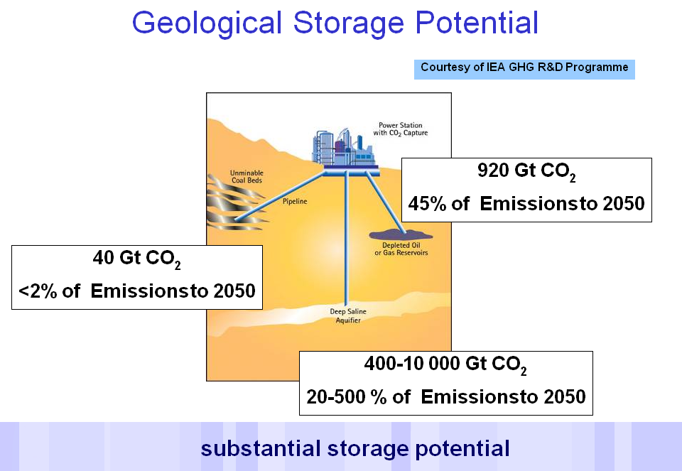

Slide 31
National Action Plan on Climate Change (NAPCC)
National Solar Mission,
National Mission for Enhanced Energy Efficiency,
National Mission on Sustainable Habitat,
National Water Mission,
National Mission for Sustaining the Himalayan Ecosystem,
National Mission for a “Green India”,
National Mission for Sustainable Agriculture,
National Mission on Strategic Knowledge for Climate Change.
The NAPCC also describes other ongoing initiatives, including:
(i) Power Generation;
(ii) Renewable Energy; and
(iii) Energy Efficiency
Parliamentary Forum on Global Warming and Climate Change—Climate Change
Action Programme (CCAP)
Indian Network for Climate Change Assessment (INCCA)
Twelfth Five-Year Plan and Climate Change

